Slide 1
Geographically Weighted Regression
The Concept of Local Spatial Regression

Slide 2
We Have Covered:
OLS Regression
Assumes that observations (and residuals) are independent, which rarely happens with geographic (spatially autocorrelated) data
Spatial Lag Regression
Assumes that the spatial autocorrelation in the OLS residuals can be accounted for by including the spatial lag of the dependent variable as a predictor in the regression.
Spatial Error Regression
Assumes that the spatial autocorrelation in the OLS residuals is due to a missing spatial variable, and includes a spatially weighted error term as a predictor in the regression

Slide 3
But…
All these methods assume that we’re dealing with spatial stationarity
Spatial stationarity: assumption that modeled relationships are constant across space.
E.g.: The relationship between median house value and crime will be the same in different parts of Philadelphia
Necessary assumption, but likely not true in practice
What if we acknowledge that we’re dealing with spatial non-stationarity?

Slide 4
Said Differently…
What if instead of having a single, global, regression, we have separate, local, regressions for each location (point, block group, tract, zip code, etc.)?
For instance, higher home values might be correlated with higher burglary rates in some locations and lower burglary rates in some others
In some areas which are poor and have low house values, burglary might be high due (partially) to the fact that the police department in that area is likely to concentrate on more serious crimes that take place there and not so much on the “commonplace” events like burglary, meaning that burglars are more likely to walk.
In some areas which are rich and have high house values, burglary might be high due to the fact that burglars may believe they’re more likely to find valuable things to steal.
This is what Geographically Weighted Regression (GWR), a method proposed by S. Fotheringham, does!

Slide 5
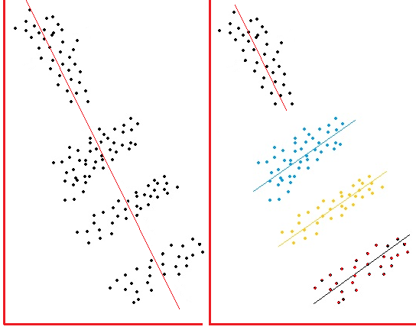
Simpson’s Paradox
# Burglaries # Burglaries
Plot on the left:
If you look at ALL block groups in Philadelphia # Burglaries and Median House Value are inversely related.
Plot on the right:
If you disaggregate the data and look at data by region (e.g., North, West, South, and Northeast Philly), you might see that there are different relationships between the two variables in different areas.
Median House Value
Median House Value

Slide 6
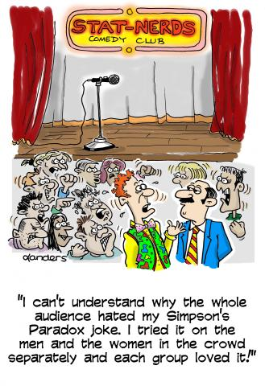
Source: www.causeweb.com

Slide 7
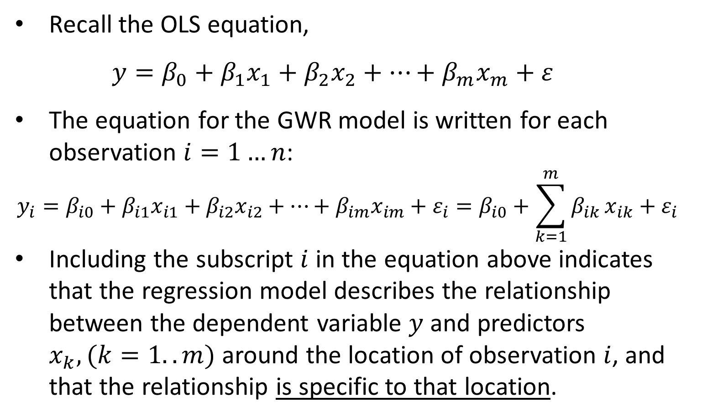
Mathematically Speaking…
Recall the OLS equation,
$$y=β_{0}+β_{1}x_{1}+β_{2}x_{2}+…+β_{m}x_{m}+ε$$
The equation for the GWR model is written for each observation $i=1…n$:
$$y_{i}=β_{i0}+β_{i1}x_{i1}+β_{i2}x_{i2}+…+β_{im}x_{im}+ε_{i}=β_{i0}+\sum_{k=1}^{m}{β_{ik}}x_{ik}+ε_{i}$$
Including the subscript $i$ in the equation above indicates that the regression model describes the relationship between the dependent variable $y$ and predictors $x_{k}, (k=1..m)$ around the location of observation $i$, and that the relationship is specific to that location.
Source: http://www.geos.ed.ac.uk/~gisteac/fspat/gwr/arcgis_gwr/GWR_WhitePaper.pdf

Slide 8
But How Is Local Regression Run?
That is, how do you run a regression for each location?
You need multiple observations (locations) to run a regression, not just a single observation (location) i !
GWR uses other observations in the dataset to run the regression; observations that are close to location i are given greater weights.
The weight of an observation varies with location i
Observations closer to i have a stronger influence on the estimation of the parameters for location i.
Source: http://wiki.landscapetoolbox.org/doku.php/spatial_analysis_methods:geographically_weighted_regression

Slide 9
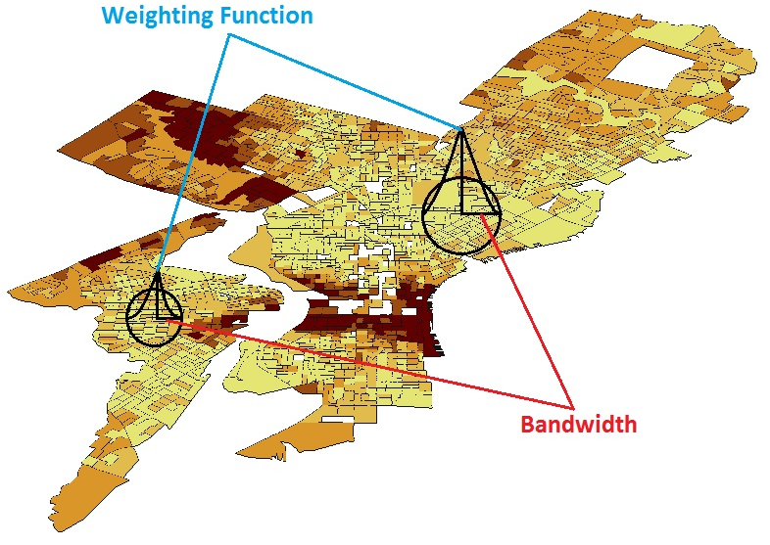
GWR Uses Nearby Observations

Slide 10
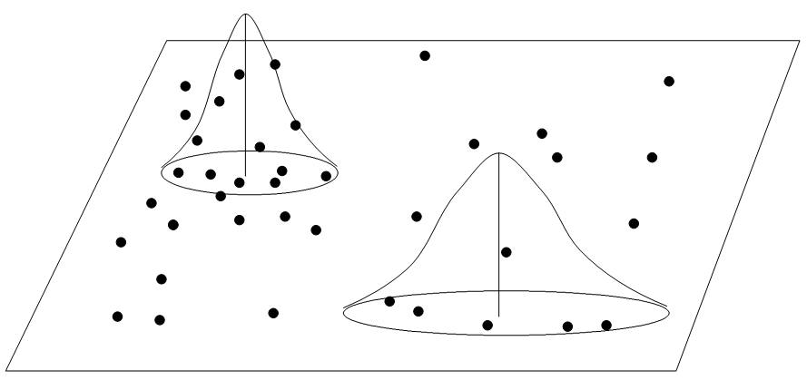
Similar Concept with Point Data
Weighting Function
Bandwidth
We will see later how to identify the appropriate bandwidth
Source: Yu, Wei, Presentation: Geographically Weighted Regression

Slide 11
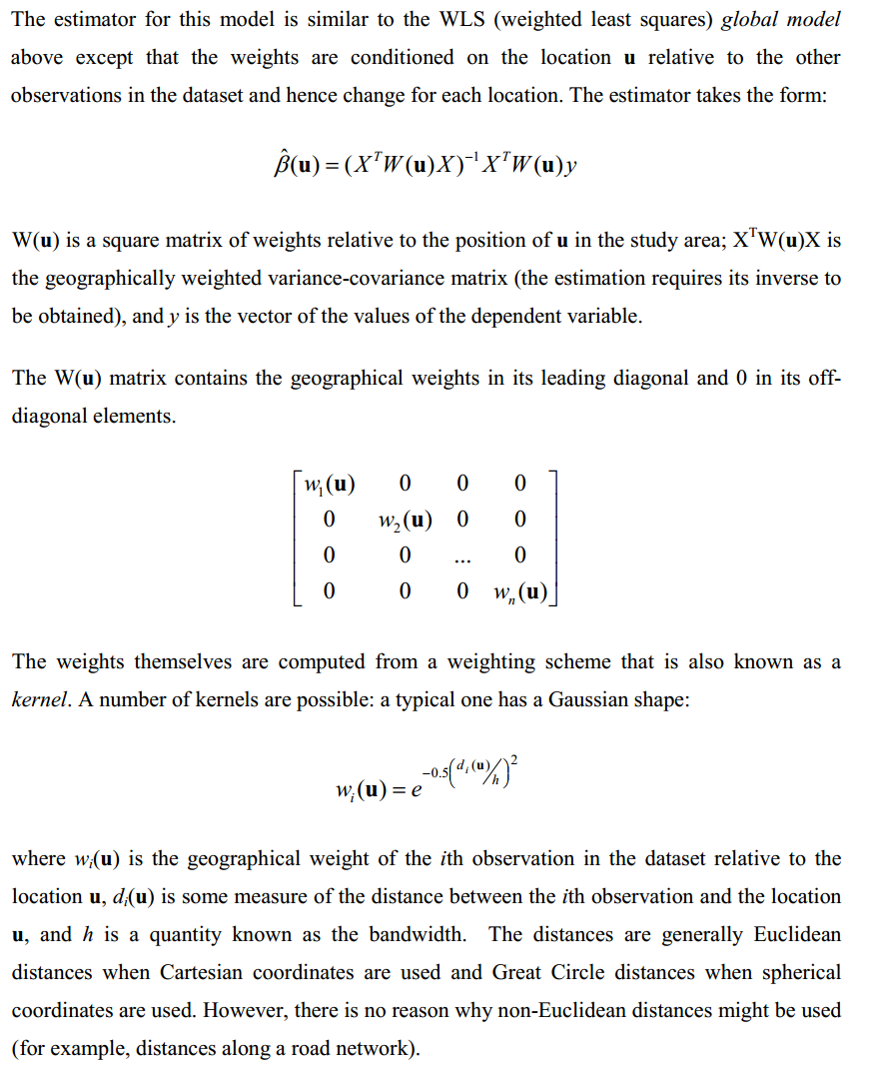
Parameter Estimation
Source: http://www.geos.ed.ac.uk/~gisteac/fspat/gwr/arcgis_gwr/GWR_WhitePaper.pdf

Slide 12
So How Do You Weigh Nearby Locations?
There are a couple ways:
Fixed bandwidth (kernel)
Variable bandwidth (kernel)
Kernel is a fancy way of saying “weighing function” and bandwidth is a fancy way of saying “distance”
Source: This slide and next few slides taken/adapted from: http://csde.washington.edu/services/gis/workshops/Resources/GWR_Presentation.pdf

Slide 13
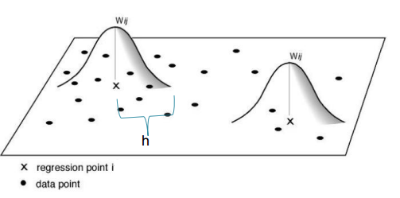
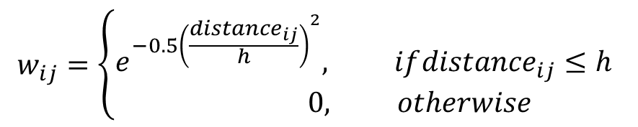

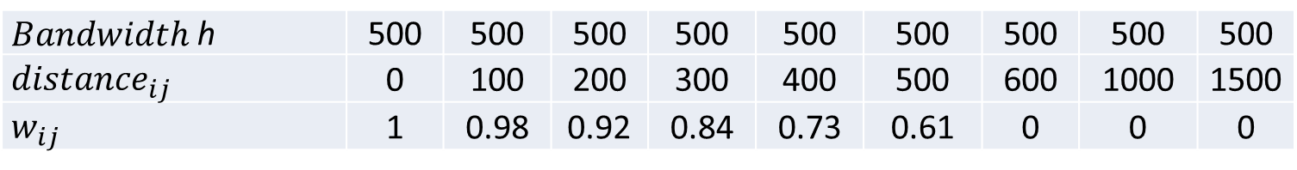
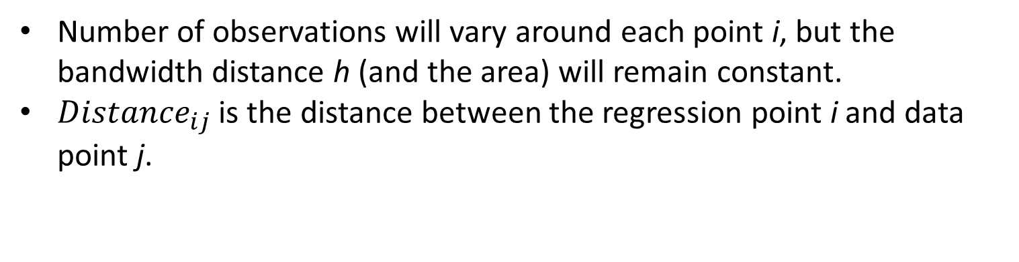
Fixed Bandwidth h
Number of observations will vary around each point i, but the bandwidth distance h (and the area) will remain constant.
${Distance}_{ij}$ is the distance between the regression point i and data point j.
$$w_{ij}=\left\{\begin{matrix}e^{−{0.5\left(\frac{{distance}_{ij}}{h}\right)}^{2}}, if{distance}_{ij}≤h \\ 0, otherwise\end{matrix}\right.$$
One way to define $w_{ij}$ is:
$Bandwidth$ h | 500 | 500 | 500 | 500 | 500 | 500 | 500 | 500 | 500
$${ distance}_{ij}$$ | 0 | 100 | 200 | 300 | 400 | 500 | 600 | 1000 | 1500
$${ w}_{ij}$$ | 1 | 0.98 | 0.92 | 0.84 | 0.73 | 0.61 | 0 | 0 | 0

Slide 14
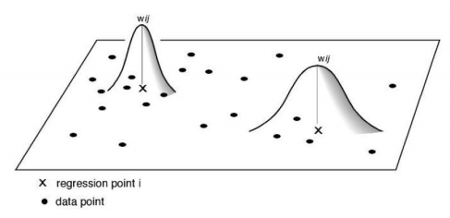

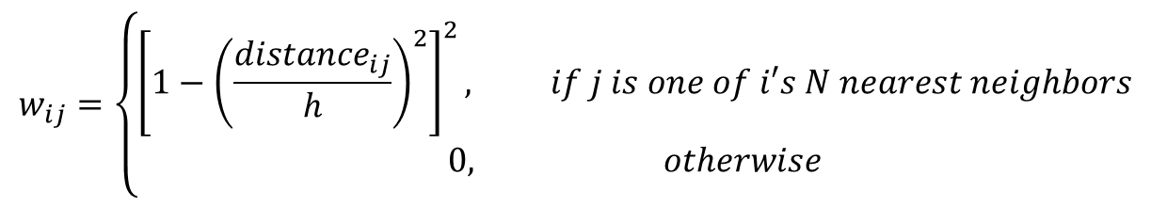
Adaptive Bandwidth h
Number of observations will remain fixed, but the area will not be the same
One way to define $w_{ij}$ is:
$$w_{ij}=\left\{\begin{matrix}\begin{aligned}{\left[1−{\left(\frac{{distance}_{ij}}{h}\right)}^{2}\right]}^{2}, if j is one of i′s N nearest neighbors \\ 0, otherwise\end{aligned} \\ \end{matrix}\right.$$
Note that in this formula h will vary from one observation to the next. Let’s assume we set N to 20 (i.e., for each observation we include 20 nearest neighbors in the regression). For observation 1, we may need to go out h = 5000 ft to get to the 20th neighbor, whereas for observation 2, we may only need to go out h = 2500 ft.

Slide 15
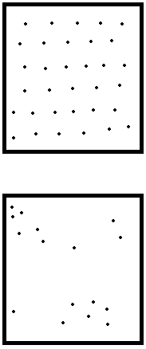
Fixed or Adaptive?
The assumptions you make about weights (i.e., bandwidth) greatly affect the results
Fixed bandwidth kernel will be more appropriate when the distribution of your observations is relatively stable across space (e.g., number of neighbors, size)
Adaptive bandwidth kernel is appropriate when distribution varies across space (i.e., events are clustered or polygons are heterogeneously shaped or sized)
Once a kernel type is selected, optimization takes some of the guesswork out of it, but robustness checks are still needed.
Use Fixed Bandwidth
Use Adaptive Bandwidth

Slide 16
Prior to Running GWR…
As with Spatial Lag and Spatial Error models, first run the OLS model to make sure that the model is reasonable, i.e., we have relationships which are worth exploring.
Very hard to check for linearity
If yes, then proceed to GWR to account for spatial autocorrelation and spatial non-stationarity.
Keep in mind that GWR has many limitations which is why a lot of spatial statisticians use it only for data exploration rather than for modeling. However, it is still a widely used tool that helps explore relationships between variables.
Source: http://www.ucl.ac.uk/scs/people/academic-research-staff/spencer-chainey/Slides/NIJCMRC2011_GWR

Slide 17
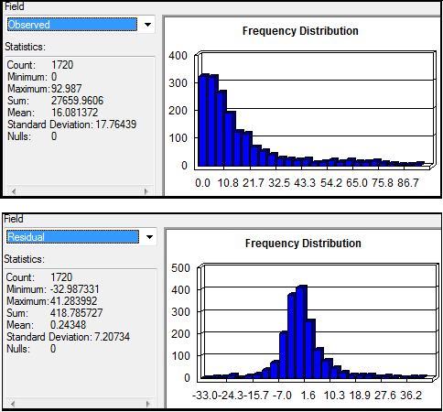
A Note on GWR Assumptions
A lot of the assumptions we have in OLS still hold in GWR.
Normality of residuals
Homoscedasticity
No multicollinearity (more on that later)
Here, dependent variable is not normal, but residuals seem close to normal-> we are probably ok.
GWR requires LOTS of observations (at least 300)!!

Slide 18
Problem at Hand
In Philadelphia, do housing characteristics do a good job of predicting the number of college educated individuals living in a particular area (block group)?
Let’s regress our dependent variable, pctbachmor (# of individuals 25 years or older who have at least a bachelor’s degree), on:
pctvacant, % of housing units which are vacant
pctsingles, % of housing units which are single (non-attached) houses

Slide 19
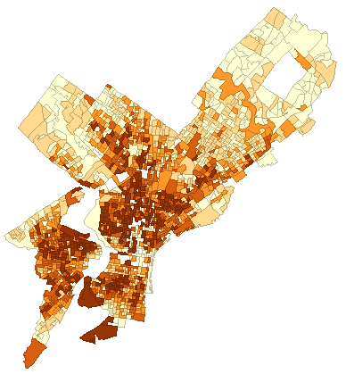
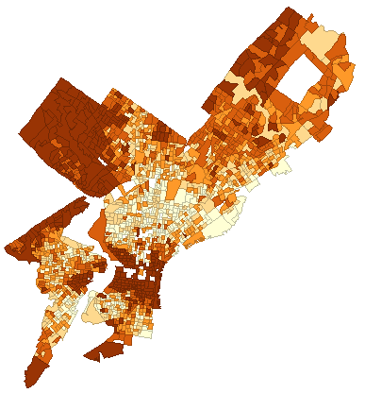
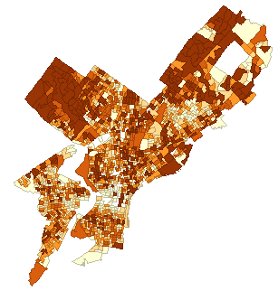
IV: PCTVACANT
DV: PCTBACHMORE
IV: PCTSINGLES

Slide 20
Let’s First Run OLS
Dependent Variable : PCTBACHMOR Number of Observations: 1720
Mean dependent var : 16.0814 Number of Variables : 3
S.D. dependent var : 17.7644 Degrees of Freedom : 1717
R-squared : 0.112782 F-statistic : 109.132
Adjusted R-squared : 0.111749 Prob(F-statistic) : 2.8026e-045
Sum squared residual: 481570 Log likelihood : -7286.44
Sigma-square : 280.472 Akaike info criterion : 14578.9**
S.E. of regression : 16.7473 Schwarz criterion : 14595.2
Sigma-square ML : 279.982 **AIC: Smaller is better.
S.E of regression ML: 16.7327
-----------------------------------------------------------------------
Variable Coefficient Std.Error t-Statistic Probability
-----------------------------------------------------------------------
CONSTANT 19.87546 0.7175294 27.69985 0.0000000
PCTVACANT -0.5070578 0.04244072 -11.94744 0.0000000
PCTSINGLES 0.2091645 0.03084245 6.78171 0.0000000
-----------------------------------------------------------------------
** THE WAY OF CALCULATING THE AIC IN ARCGIS IS ESSENTIALLY IDENTICAL.

Slide 21
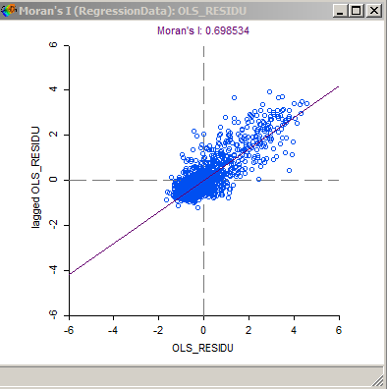
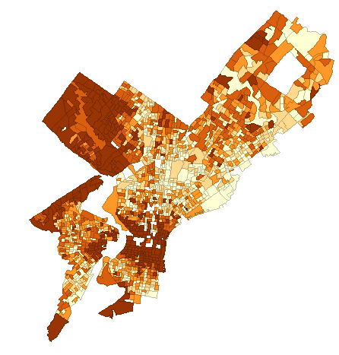
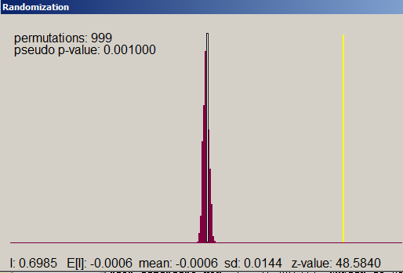
OLS Residuals
Queen Weight Matrix

Slide 22
Discussion of OLS Results
From the results, we see that even though the R² of the model is pretty low (0.11), both predictors are statistically significant (p<0.0001), and the overall model is significant also (F statistic = 109, p < 0.0001).
There is no multicollinearity here.
We’ll assume for the sake of the example that the assumptions of normality and heteroscedasticity are met.
Not really the case in practice if we look at the results of the Jarque-Bera normality of errors test, or the Breusch-Pagan test for heteroscedasticity.
Residuals are spatially autocorrelated, as indicated by the Moran’s I results.
Now, we need to take into account the spatial dependencies in the data.
Let’s use GWR! Recall: Use projected coordinate systems!

Slide 23
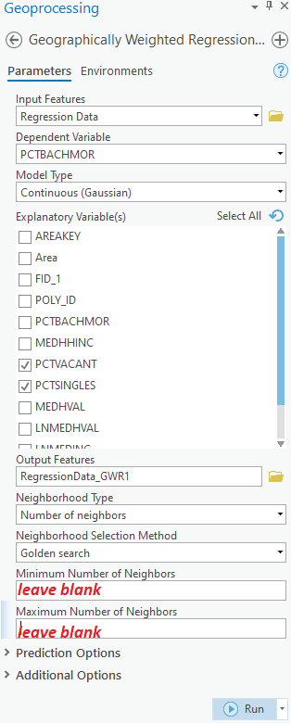
As an example of what NOT to do, let’s Run GWR In AcrGIS Pro…
Neighborhood Type refers to bandwidth. We can select “number of neighbors” (adaptive) or distance band (fixed).
In the Command Search window, type GWR…
Click Run!

Slide 24
Which Bandwidth Should We Pick?
In previous versions of ArcGIS (e.g., ArcMap) if we were dealing with the fixed bandwidth, we enter it into ArcGIS; if we’re dealing with the adaptive bandwidth, we enter the number of nearest neighbors to be included.
Alternatively, we can let ArcGIS identify the best bandwidth based on cross-validation or by minimizing the AIC (Akaike Information Criterion)
ArcGIS Pro has a very different, and very confusing, way of optimizing bandwidth
Notes:
$$CV=\sum_{i}{{\left(y_{i}−{\hat{y}}_{≠i}(h)\right)}^{2}}$$
Here, ${\hat{y}}_{≠i}(h)$ is the fitted value of $y_{i}$ with data from point i omitted from the calibration and only points near to i are used. Lower values of CV indicate better model fits. This is, essentially, a way of calculating the SSE.
In English: for each observation i, run regression using ONLY nearby observations j within bandwidth h, but EXCLUDING i. Then, using the obtained Beta coefficients, calculate y-hat and residual for i. When we get the residuals for each i, we can compute the quantity for CV in the formula above (SSE), or the RMSE. We repeat this process for multiple bandwidths h and pick the model with the lowest CV score (i.e., lowest SSE or RMSE).
For more information on cross-validation in local regression, see:
Cleveland W.S. (1979). Robust Locally Weighted Regression and Smoothing Scatterplots. Journal of the American Statistical Association, 74: 829-36.
Brunsdon C., Fotheringham A.S. & Charlton M.E. (1996). Geographically Weighted Regression: A Method for Exploring Spatial Nonstationarity. Geographical Analysis, 28(4).

Slide 25
In ArcGIS Pro…[don’t bother reading]
The Neighborhood Selection Method parameter specifies how the size of the neighborhood is determined (the actual distance or number of neighbors used). The neighborhood selected with the Golden search or Manual intervals option is always based on minimizing the value of the Akaike Information Criterion (AICc). Alternatively, you can set a specific neighborhood distance or number of neighbors with the User defined option.
When the Golden search option is chosen, the tool determines the best values for the Distance band or Number of neighbors parameter using the golden section search method. Golden search first finds maximum and minimum distances and tests the AICc at various distances incrementally between them. When there are more than 1000 features in a dataset, the maximum distance is the distance at which any feature has at most 1000 neighbors. The minimum distance is the distance at which every feature has at least 20 neighbors. If there are less than 1000 features, the maximum distance is the distance at which every feature has n/2 neighbors (half the number of features as neighbors), and the minimum distance is the distance at which every feature has at least 5 percent of n (5 percent of the features in the dataset as neighbors). Golden search determines the distance or number of neighbors with the lowest AICc as the neighborhood size.
You may get this warning
110306: The final model didn't have the lowest AICc encountered in the Golden Search Results:
The Golden Search algorithm is not guaranteed to find the lowest possible AICc for Number of neighbors or Distance band. One of the values in the Golden Search Results section of the geoprocessing messages had a lower AICc than the final value identified by Golden Search.
No action is required. However, consider running the tool again using the User defined option for Neighborhood Selection Method and providing the number of neighbors or distance band that corresponds to the lowest AICc.
https://pro.arcgis.com/en/pro-app/latest/tool-reference/spatial-statistics/how-geographicallyweightedregression-works.htm
https://pro.arcgis.com/en/pro-app/latest/tool-reference/tool-errors-and-warnings/110001-120000/tool-errors-and-warnings-110301-110325-110306.htm

Slide 26
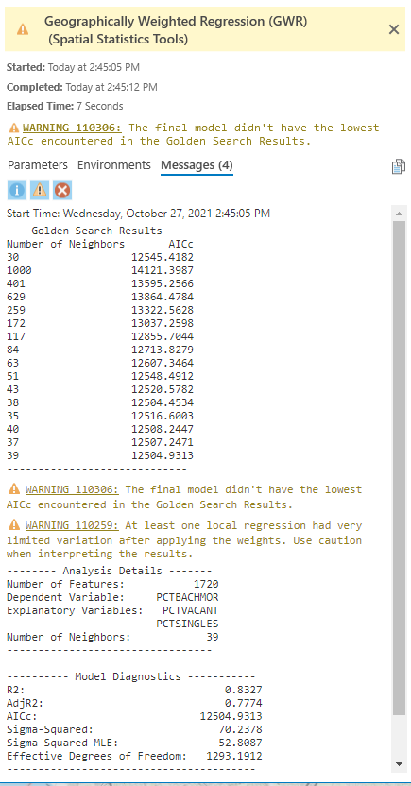
ArcGIS Pro Results
The optimal number of neighbors identified is 39. This corresponds to AICc of 12504.9313.
Here, AICc is the corrected AIC, that includes an extra penalty term for the number of parameters.
AICc should not be compared to AIC. They are two different statistics.
ArcGIS Pro does not give AIC, just AICc, which makes it difficult to compare GWR output to other models.

Slide 27


Slide 28

Arc

Slide 29
Making Sense of the GWR Output
The output consists of:
A map (and attribute table) which contains the regression standardized residuals and a bunch of other local statistics (for each observation)
GeographicallyWeightedRegression5.shp
A supplementary table which contains the overall (global) regression results
In ArcGIS Pro, this is the information that you can get in the messages tab of the GWR tool

Slide 30
Supplementary Table (Cont’d)
AIC (and AICc)
This is a measure of model performance and is helpful for comparing different regression models.
Taking into account model complexity, the model with the lower AIC value provides a better fit to the observed data.
However, when the sample size is small, there’s a relatively high chance that AIC will select models with too many parameters, and a correction for small sample sizes is needed. This is called the Corrected AIC (AICc).
Neither the AIC nor the AICc are absolute measures of goodness of fit, but they are useful for comparing models with different explanatory variables as long as they apply to the same dependent variable.
If the AIC values for two models differ by more than 3, the model with the lower AIC is held to be better. Same with AICc. A difference of less than 3 isn’t considered substantial enough to say that one model is better than the other.
In earlier versions of ArcGIS, the AIC was reported; Currently, in ArcGIS Pro, AICc is reported.
We should NOT compare AICc in GWR to the AIC in OLS, SL or SE – these are different measures.
You can get AIC (and AICc) for GWR in R (see R Markdown showing how to run spatial analyses). You can compare that AIC to the AIC in the other models.
Source for slides: http://resources.esri.com/help/9.3/arcgisdesktop/com/gp_toolref/spatial_statistics_tools/interpreting_gwr_results.htm

Slide 31
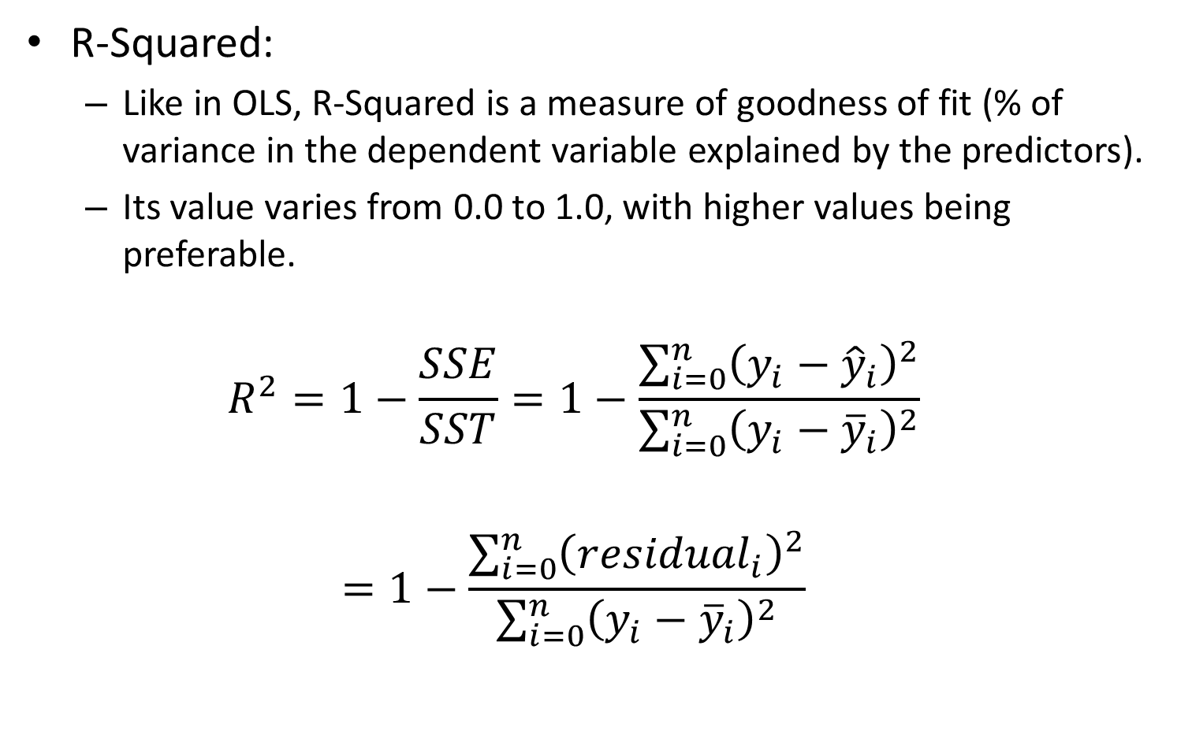
Supplementary Table (Cont’d)
R-Squared:
Like in OLS, R-Squared is a measure of goodness of fit (% of variance in the dependent variable explained by the predictors).
Its value varies from 0.0 to 1.0, with higher values being preferable.
$$R^{2}=1−\frac{SSE}{SST}=1−\frac{\sum_{i=0}^{n}{{\left(y_{i}−{\hat{y}}_{i}\right)}^{2}}}{\sum_{i=0}^{n}{{\left(y_{i}−{\overline{y}}_{i}\right)}^{2}}}$$
$$=1−\frac{\sum_{i=0}^{n}{{\left({residual}_{i}\right)}^{2}}}{\sum_{i=0}^{n}{{\left(y_{i}−{\overline{y}}_{i}\right)}^{2}}}$$

Slide 32
Supplementary Table (Cont’d)
R-Squared Adjusted:
Adjusts R-squared by the number of predictors in the model
Almost always smaller than the R-Squared model.
However, in making this adjustment, you lose the interpretation of the value as a proportion of the variance explained.
AICc are preferred to R-Squared and Adjusted R-Squared as a means of comparing models

Slide 33
ArcGIS Pro Issues
In the current and earlier versions of ArcGIS Pro, some local R-squares are negative, which obviously makes no sense
The results in ArcMap and R are consistent with one another, but ArcGIS Pro is WRONG.
Do not use ArcGIS for GWR.
Use R!

Slide 34
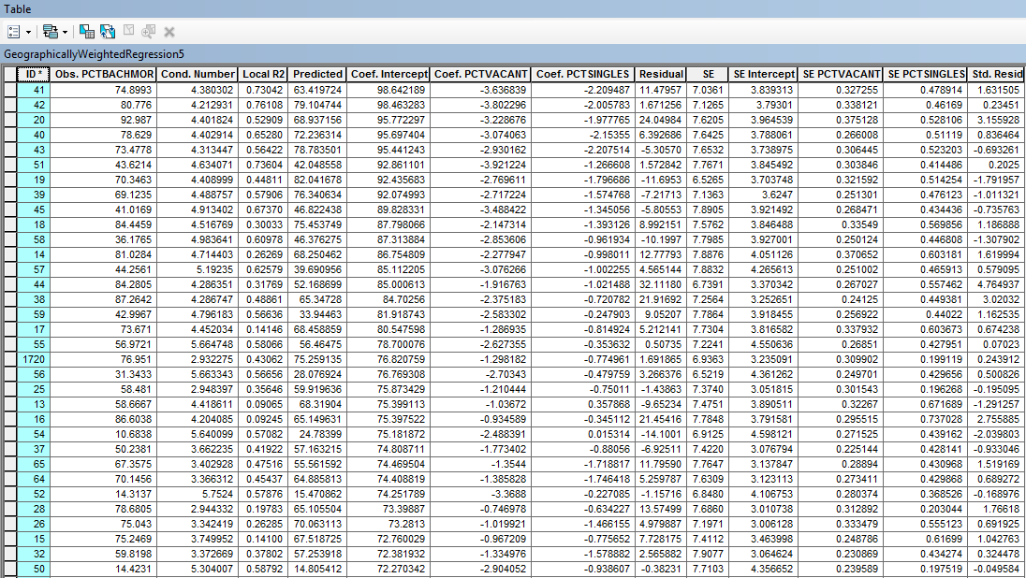
Attribute Table of GWR Results

Slide 35
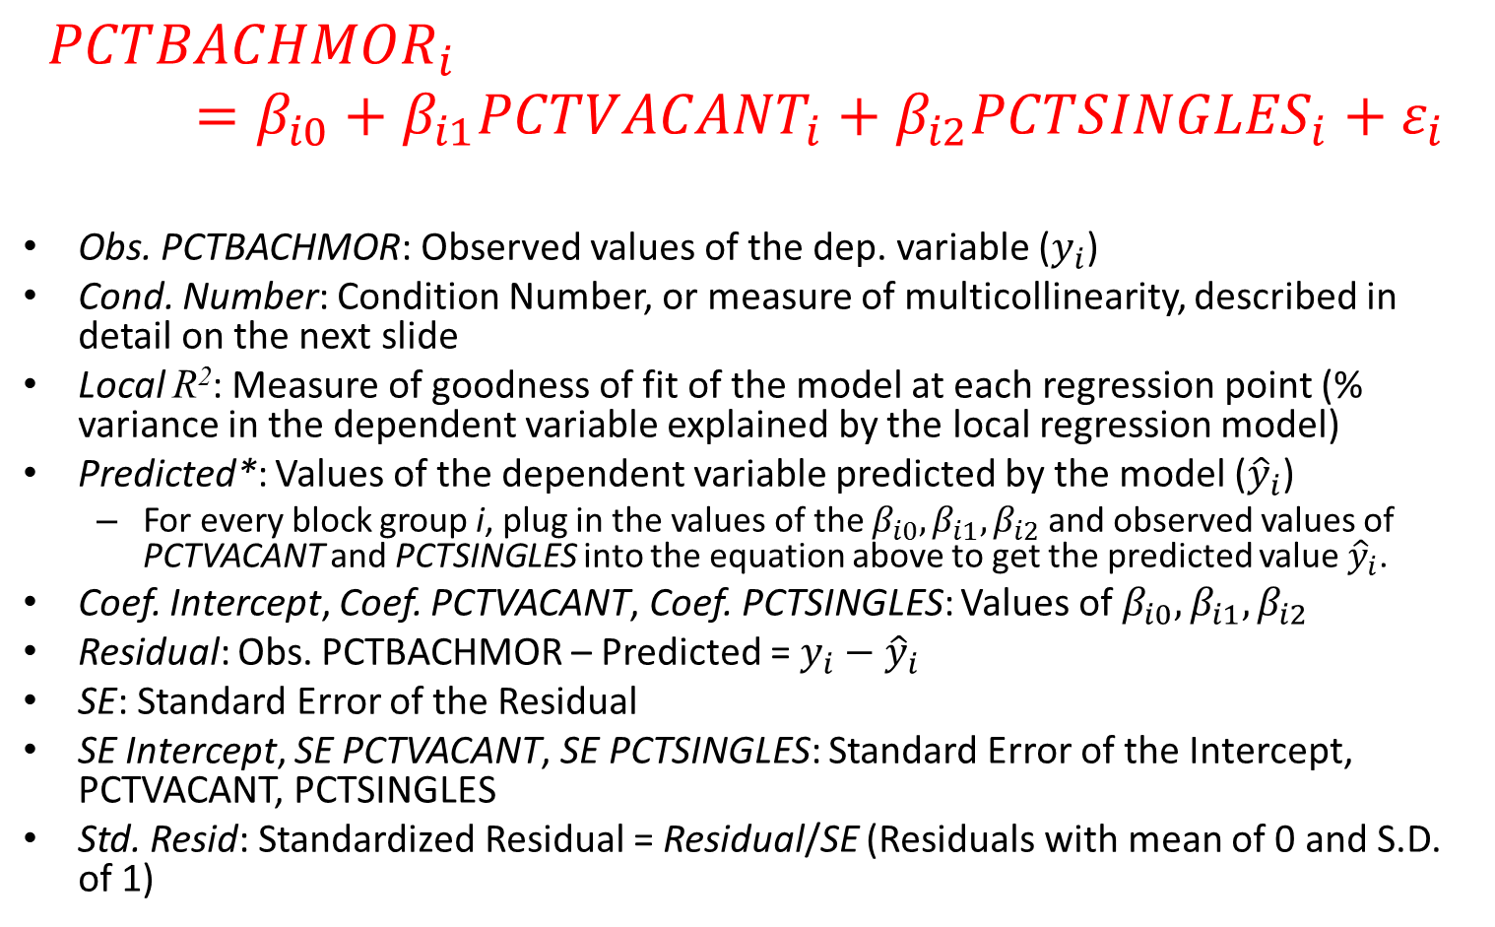
What Do Variables in the Attribute Table Mean?
$${PCTBACHMOR}_{i}=β_{i0}+β_{i1}{PCTVACANT}_{i}+β_{i2}{PCTSINGLES}_{i}+ε_{i}$$
Obs. PCTBACHMOR: Observed values of the dep. variable ($y_{i}$)
Cond. Number: Condition Number, or measure of multicollinearity, described in detail on the next slide
Local R²: Measure of goodness of fit of the model at each regression point (% variance in the dependent variable explained by the local regression model)
Predicted*: Values of the dependent variable predicted by the model (${\hat{y}}_{i}$)
For every block group i, plug in the values of the $β_{i0},β_{i1},β_{i2}$ and observed values of PCTVACANT and PCTSINGLES into the equation above to get the predicted value ${\hat{y}}_{i}$.
Coef. Intercept, Coef. PCTVACANT, Coef. PCTSINGLES: Values of $β_{i0},β_{i1},β_{i2}$
Residual: Obs. PCTBACHMOR – Predicted = $y_{i}−{\hat{y}}_{i}$
SE: Standard Error of the Residual
SE Intercept, SE PCTVACANT, SE PCTSINGLES: Standard Error of the Intercept, PCTVACANT, PCTSINGLES
Std. Resid: Standardized Residual = Residual/SE (Residuals with mean of 0 and S.D. of 1)
Notes:
See the Excel Spreadsheet

Slide 36
Multicollinearity/Clustering
In global regression models, such as OLS, results are unreliable when two or more variables exhibit multicollinearity.
That is, one of the variables is “redundant” because it tells the same story as the second one
GWR builds a local regression equation for each feature in the dataset. When the value for an explanatory variable cluster spatially in a substantial way, you will very likely have a problem.
That is, the variable tells the same story at every location (there’s not enough variability)
Also, you may have a problem with multicollinearity when you have 2+ variables that have similar patterns of clusters in a certain region
E.g., we may run into problems if we use two variables which both have very high (or very low) values at all locations in a certain part of the study region.
The condition number in the attribute table indicates when results are unstable due to local multicollinearity (field Cond. Number). As a rule of thumb, do not trust results for features with a condition number larger than 30; equal to Null; or equal to -1.7976931348623158e + 308.
There seem to be issues with some observations in this case!
NOTE: The current version of ArcGIS Pro seems to have problems with calculating this condition number – substantially higher values are reported than in older versions of ArcGIS and in R.
Source: http://webhelp.esri.com/arcgisdesktop/9.3/index.cfm?TopicName=Geographically%20Weighted%20Regression%20(Spatial%20Statistics)

Slide 37
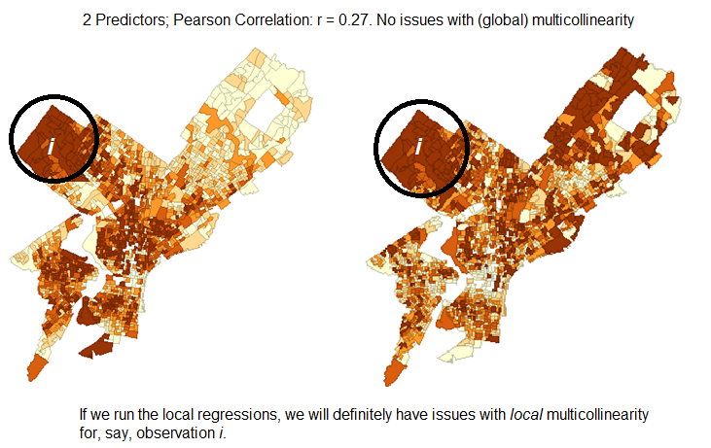
Local Multicollinearity: Similar patterns in 2+ predictors for some locations

Slide 38
A Note About Categorical and Dummy Predictors
Caution should be used when including nominal/categorical data in a GWR model. Where categories cluster spatially, there is strong risk of encountering local multicollinearity issues. Results in the presence of local multicollinearity are unstable, or models simply cannot be run.
Do not use "dummy" explanatory variables to represent different spatial regimes in a GWR model (e.g., block groups outside center city are assigned a value of 1, while all others are assigned a value of 0). Because GWR allows explanatory variable coefficients to vary, these spatial regime explanatory variables are unnecessary, and if included, will create problems with local multicollinearity
Source: http://resources.arcgis.com/en/help/main/10.1/index.html#//005p00000021000000

Slide 39
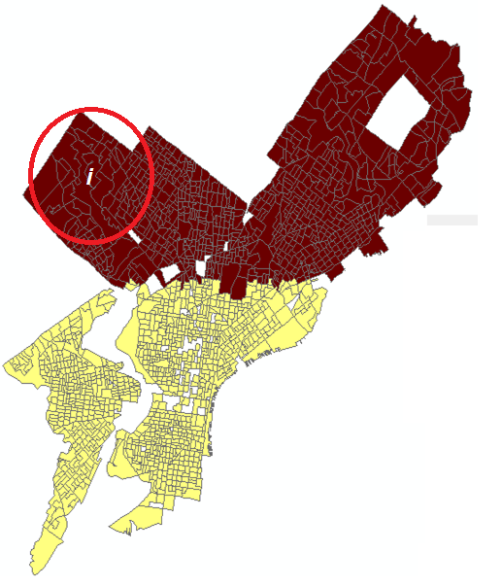
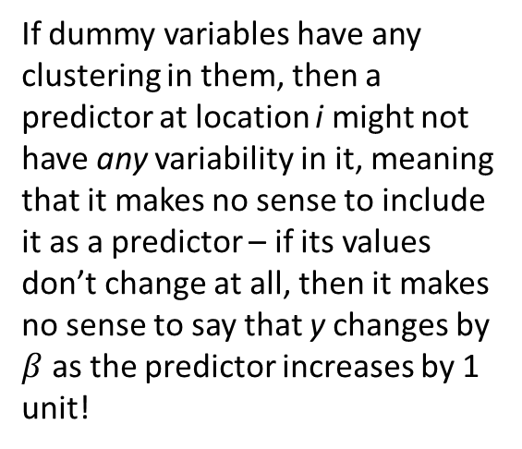
Problems with Dummy/Categorical Variables
If dummy variables have any clustering in them, then a predictor at location i might not have any variability in it, meaning that it makes no sense to include it as a predictor – if its values don’t change at all, then it makes no sense to say that y changes by $β$ as the predictor increases by 1 unit!

Slide 40

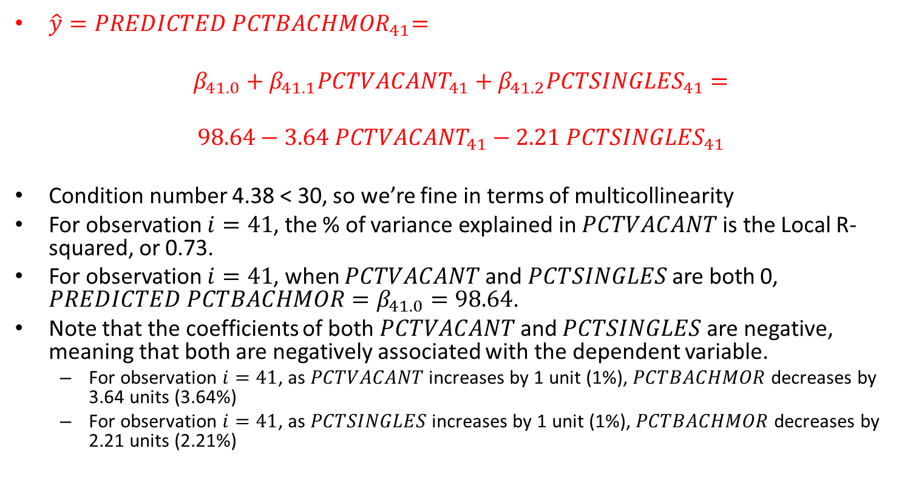
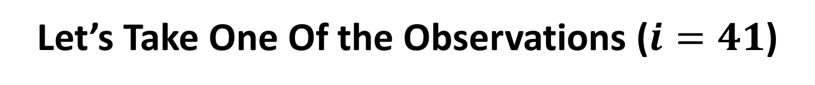
Let’s Take One Of the Observations ($i=41$)
$\hat{y}{=PREDICTED PCTBACHMOR}_{41}=$
$$β_{41.0}+β_{41.1}{PCTVACANT}_{41}+β_{41.2}{PCTSINGLES}_{41}=$$
$$98.64−3.64{ PCTVACANT}_{41}−2.21 {PCTSINGLES}_{41}$$
Condition number 4.38 < 30, so we’re fine in terms of multicollinearity
For observation $i=41$, the % of variance explained in $PCTVACANT$is the Local R-squared, or 0.73.
For observation $i=41$, when $PCTVACANT$ and $PCTSINGLES$ are both 0, $PREDICTED PCTBACHMOR=β_{41.0}=98.64$.
Note that the coefficients of both $PCTVACANT$ and $PCTSINGLES$ are negative, meaning that both are negatively associated with the dependent variable.
For observation $i=41$, as $PCTVACANT$ increases by 1 unit (1%), $PCTBACHMOR$decreases by 3.64 units (3.64%)
For observation $i=41$, as $PCTSINGLES$ increases by 1 unit (1%), $PCTBACHMOR$decreases by 2.21 units (2.21%)

Slide 41
But Where are the P-Values?
Recall that in a global model such as OLS it is usual to test whether the parameter estimates are significantly different from zero.
This can be accomplished with a t-test – the t statistics and their associated p-values are usually provided on the computer output.
The situation with GWR is a little more complex and is the subject of current research.
As there is one set of parameters associated with each regression point, as well as one set of standard errors, then there are potentially hundreds or thousands of tests that would be required to determine whether parameters are locally significant.
Recall the concept of type I error: if the α=0.05 significance level is used, we would expect 5 tests in every 100 to be significant when in reality they are not! (And we would also expect some significant results to be not significant when in reality they are – type II error).
With a 4 predictor model estimated at 2000 regression points, there would be 10000 significance tests (5 per point – 1 for the intercept and 4 for the predictors) would be we would expect 500 of these tests to return a significant result simply by chance (i.e., when they’re not significant in reality). This is the problem with multiple testing.
There are ways to adjust for multiple testing, but they are not currently implemented in ArcGIS
Source: http://www.geos.ed.ac.uk/~gisteac/fspat/gwr/arcgis_gwr/GWR_WhitePaper.pdf
Notes:
Draw on board.

Slide 42
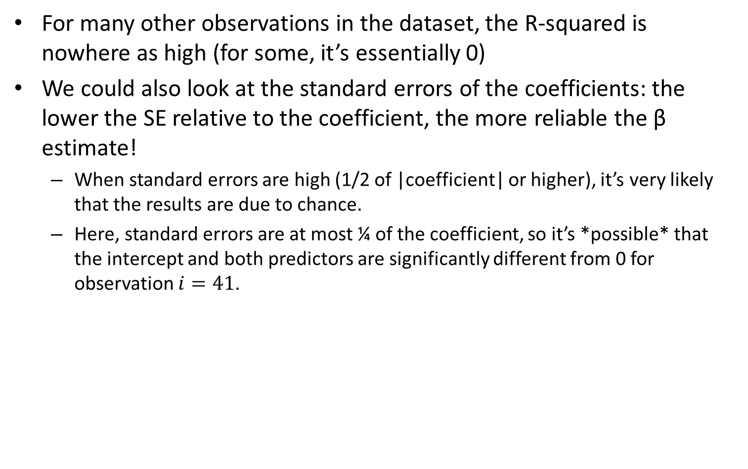
Some Notes on Local Results
For many other observations in the dataset, the R-squared is nowhere as high (for some, it’s essentially 0)
We could also look at the standard errors of the coefficients: the lower the SE relative to the coefficient, the more reliable the β estimate!
When standard errors are high (1/2 of |coefficient| or higher), it’s very likely that the results are due to chance.
Here, standard errors are at most ¼ of the coefficient, so it’s *possible* that the intercept and both predictors are significantly different from 0 for observation $i=41$.
 | Coefficient β | SE | (β/SE)**
Intercept | 98.64 | 3.84 | 25.67
PCTVACANT | -3.64 | 0.33 | -11.03
PCTSINGLES | -2.21 | 0.48 | -4.60
** This would be the t-statistic in a global model; t-statistics lower than 2 (or 1.96 when n is high) correspond to p-values > 0.05 (non-significant results).

Slide 43
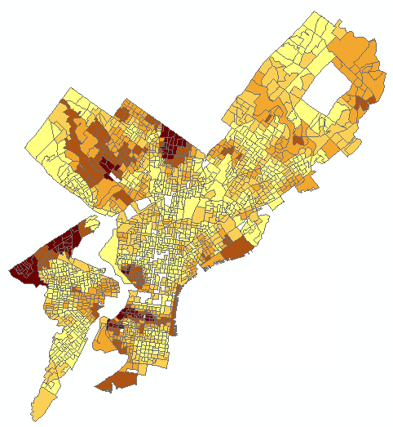
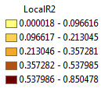
Let’s Map Some Local Statistics!
Note how much the R-squares vary throughout the city!
Lousy fit in most parts of Philadelphia, and very good fit in some others.
ArcGIS Pro occasionally reports negative local R-squares. This seems to be an implementation error.

Slide 44
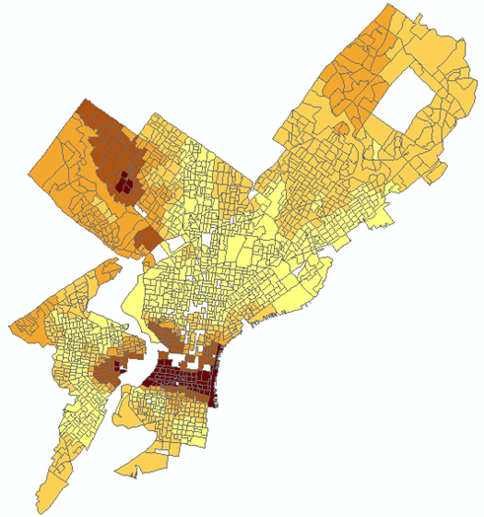
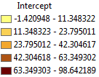
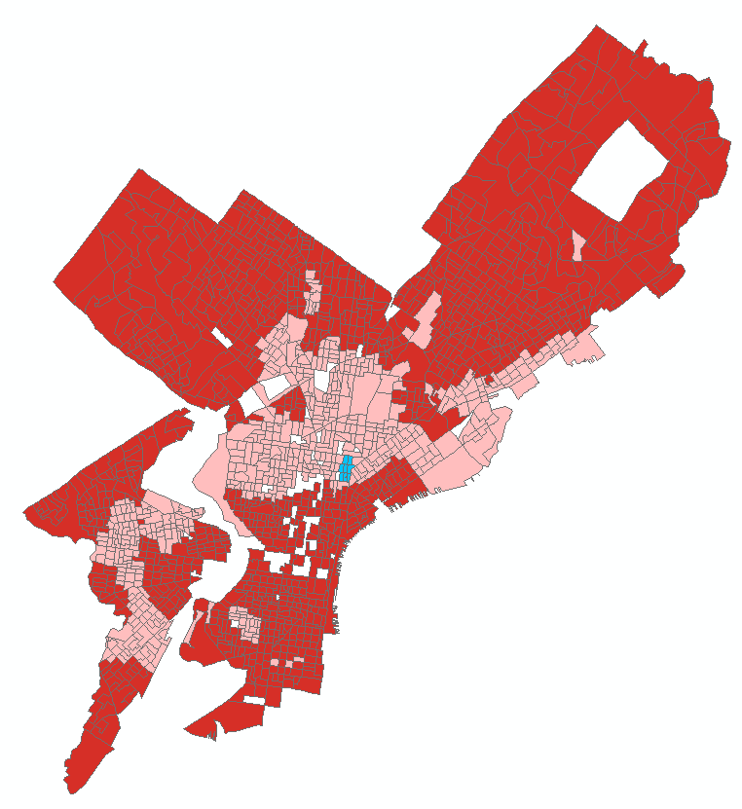
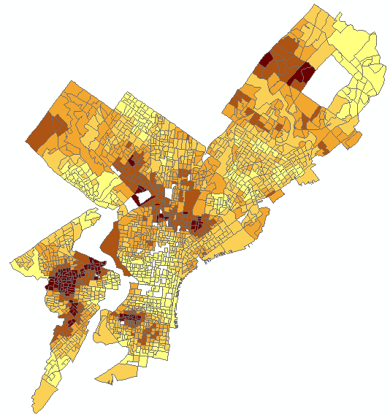

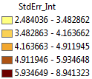
INTERCEPT
Intercept/SE
The light blue are negative values between -.33 and 0 (probably not significant)
The pink are positive values between 0 and 2 (probably not significant)
The red are positive values above 2 (possibly significant)

Slide 45
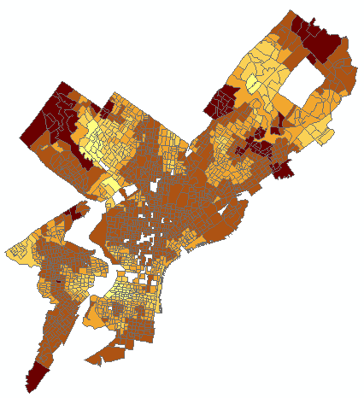
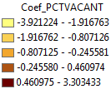
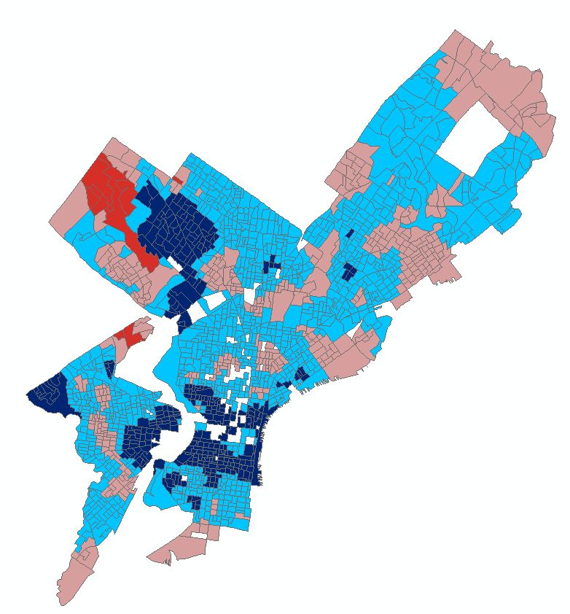
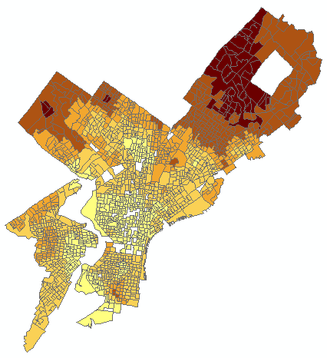

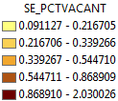
PCTVACANT
Coef_PCTVACANT/SE
The dark blue are negative values below -2 (possibly significant).
The red are positive values above 2 (possibly significant)

Slide 46
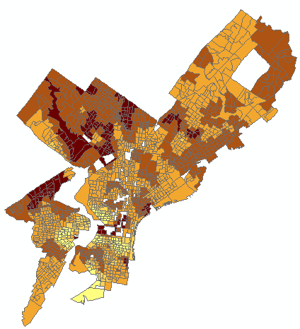
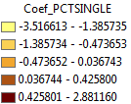
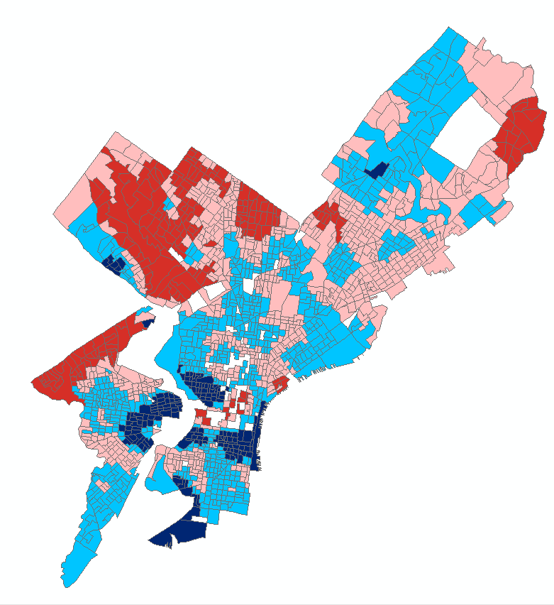
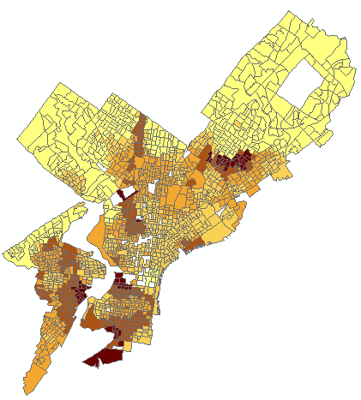

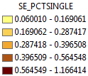
PCTSINGLES
Coef_PCTSINGLES/SE
The dark blue are negative values below -2 (possibly significant).
The red are positive values above 2 (possibly significant)

Slide 47
A Note on Presenting Coef/SE Results
When we present the spatial distribution of Coefficient/SE, we may wish to have the following breaks and color schemes:
Coef/SE <= -2: A negative relationship with the dependent variable that’s possibly significant
Dark Blue
- 2 < Coef/SE <= 0: A negative relationship with the dependent variable that’s likely not significant
Light Blue
0 < Coef/SE < 2: A positive relationship with the dependent variable that’s likely not significant
Pink
Coef/SE >= 2: A positive relationship with the dependent variable that’s possibly significant
Dark Red

Slide 48
Going Over Results On Previous Slides
Examine the maps on the previous slides to better understand regional variation in the model explanatory variables.
We are interested in examining how spatially consistent (stationary) relationships between the dependent variable and each explanatory variable are across the study area.
Examining the coefficient distribution as a surface shows where and how much variation is present. You can use your understanding of this variation to inform policy.
In general:
Statistically significant global variables that exhibit little regional variation inform region wide policy.
Statistically significant global variables that exhibit strong regional variation inform local policy: This is what we have here!
Some variables may not be globally significant, because in some regions they are positively related and others they are negatively related: This is what we have here!
Vast spatial variation in coefficient estimates may mean that important predictors are omitted from the model (e.g., median house value; median household income)
Source: http://webhelp.esri.com/arcgisdesktop/9.3/index.cfm?TopicName=Interpreting_GWR_results

Slide 49
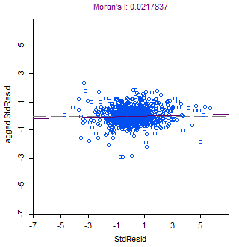
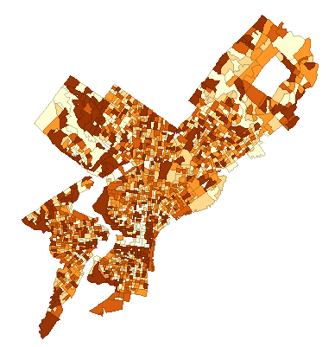


Are Residuals Spatially Autocorrelated?
Bring GeographicallyWeightedRegression5.shp into GeoDa and look at Moran’s I.

Slide 50
Compare to Spatial Lag Regression
Data set : Regression_Data
Spatial Weight : Regression_Data.gal (QUEEN)
Dependent Variable : PCTBACHMOR Number of Observations: 1720
Mean dependent var : 16.0814 Number of Variables : 4
S.D. dependent var : 17.7644 Degrees of Freedom : 1716
Lag coeff. (Rho) : 0.855864
R-squared : 0.748861 Log likelihood : -6365.78
Sq. Correlation : - Akaike info criterion : 12739.6
Sigma-square : 79.2529 Schwarz criterion : 12761.4
S.E of regression : 8.90241
-----------------------------------------------------------------------
Variable Coefficient Std.Error z-value Probability
-----------------------------------------------------------------------
W_PCTBACHMOR 0.8558641 0.01303343 65.66682 0.0000000
CONSTANT 3.458982 0.4646148 7.44484 0.0000000
PCTVACANT -0.1615949 0.02346059 -6.887933 0.0000000
PCTSINGLES 0.08481998 0.01661929 5.103707 0.0000003
-----------------------------------------------------------------------

Slide 51




Spatial Lag Residuals

Slide 52
Compare to Spatial Error Regression
Data set : Regression_Data
Spatial Weight : Regression_Data.gal (QUEEN)
Dependent Variable : PCTBACHMOR Number of Observations: 1720
Mean dependent var : 16.081372 Number of Variables : 3
S.D. dependent var : 17.764392 Degrees of Freedom : 1717
Lag coeff. (Lambda) : 0.871578
R-squared : 0.747183 R-squared (BUSE) : -
Sq. Correlation : - Log likelihood :-6381.287403
Sigma-square : 79.7824 Akaike info criterion : 12768.6
S.E of regression : 8.9321 Schwarz criterion : 12784.9
-----------------------------------------------------------------------
Variable Coefficient Std.Error z-value Probability
-----------------------------------------------------------------------
CONSTANT 17.82738 1.723023 10.34657 0.0000000
PCTVACANT -0.1628771 0.02833427 -5.748414 0.0000000
PCTSINGLES 0.08879694 0.01957964 4.535168 0.0000058
LAMBDA 0.8715781 0.01303607 66.85895 0.0000000
-----------------------------------------------------------------------

Slide 53




Spatial Error Residuals

Slide 54
Is GWR Better than Other Models Here?
Seems that GWR is a better model than OLS
Accounts for potential spatial non-stationarity
Yields a better fit (better R-squared)
GWR with different specs still yield lower AICs than OLS
However, we should not compare GWR AICc with the OLS AIC.
No spatial autocorrelation in residuals in GWR, but spatial autocorrelation in OLS
Seems that GWR is a better model than SE and SL
No spatial autocorrelation in residuals in GWR, but a little spatial autocorrelation left in residuals in SE and SL
We can get the GWR AIC in R, and compare with the AIC of SE and SL models
Keep in mind the limitations of GWR
Many spatial statisticians think of GWR as an exploratory tool and not as a substitute for other spatial regression models

